Slide 1
Software Engineering
Lecture #30
Fakhar Lodhi

Slide 2
Recap

Slide 3
Summary of Today’s Lecture

Slide 4
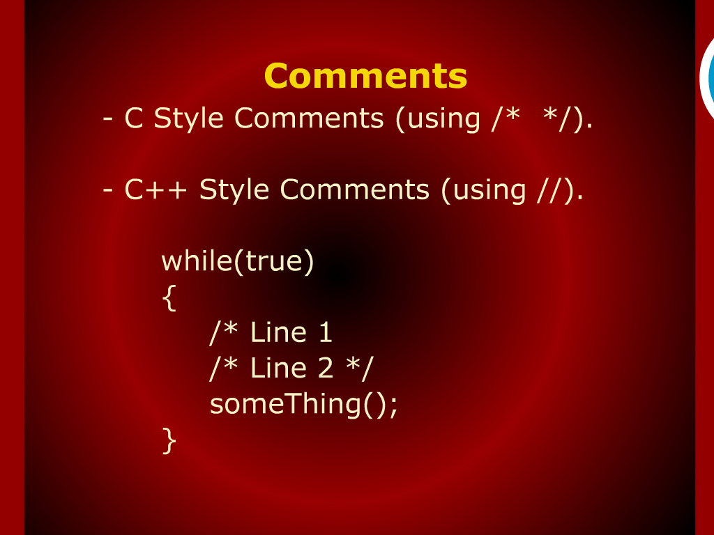
Comments

Slide 5
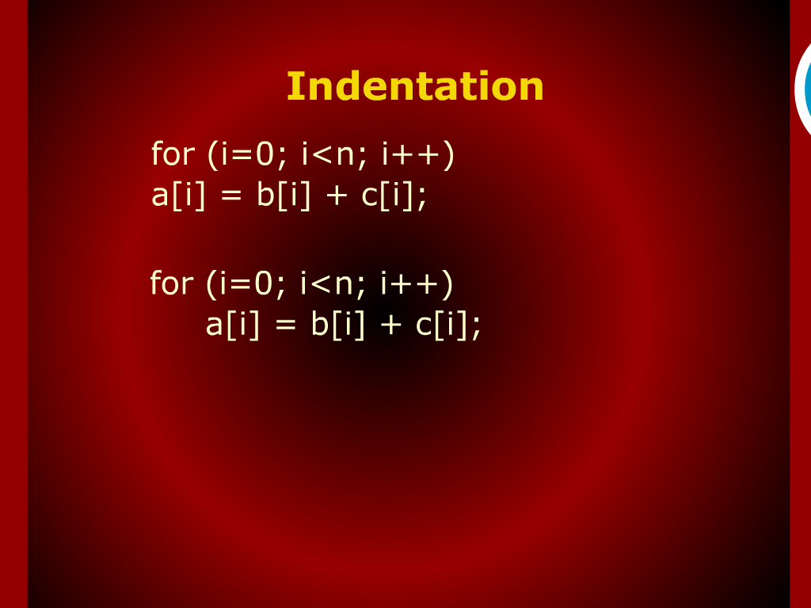
Indentation

Slide 6
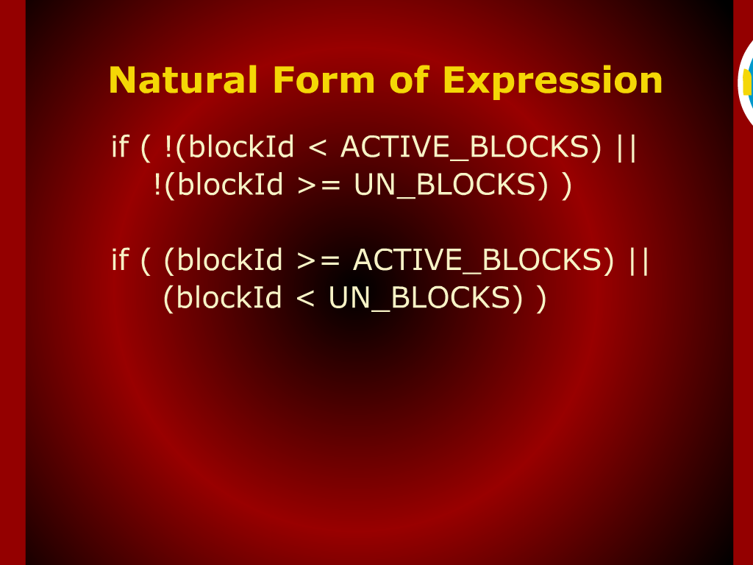
Natural Form of Expression

Slide 7
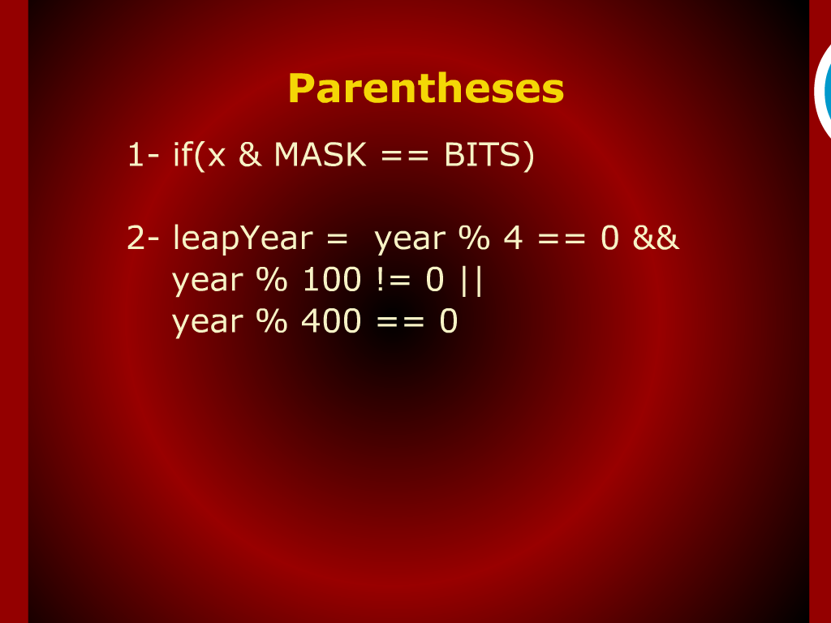
Parentheses

Slide 8
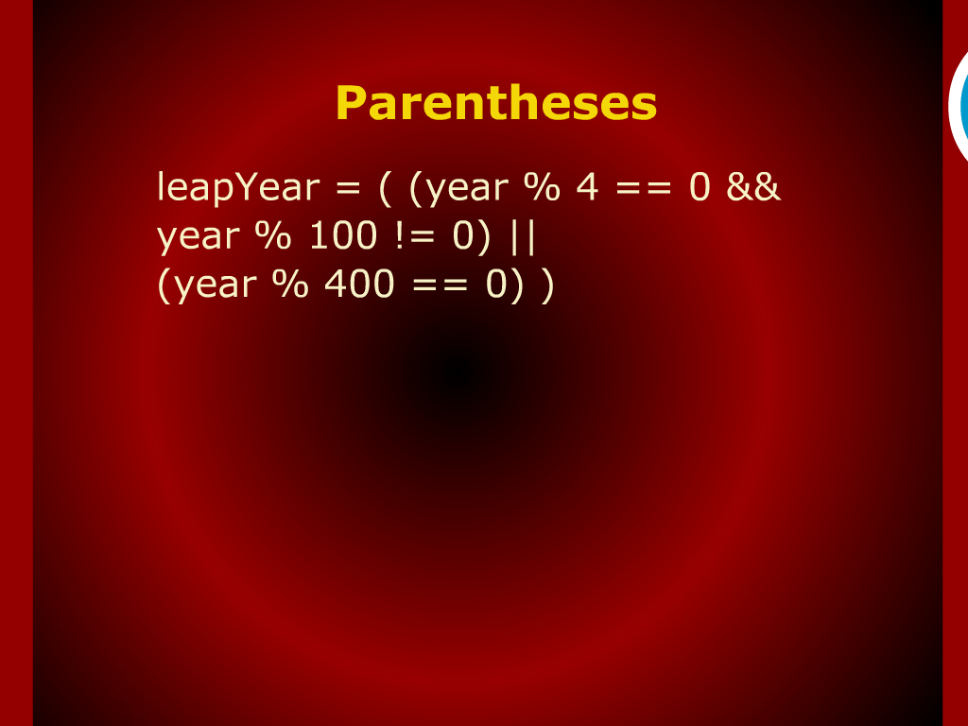
Parentheses

Slide 9
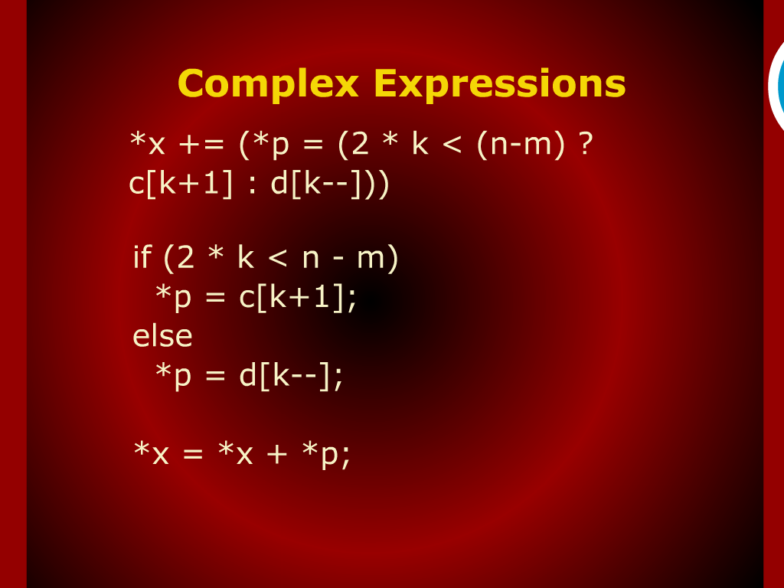
Complex Expressions

Slide 10
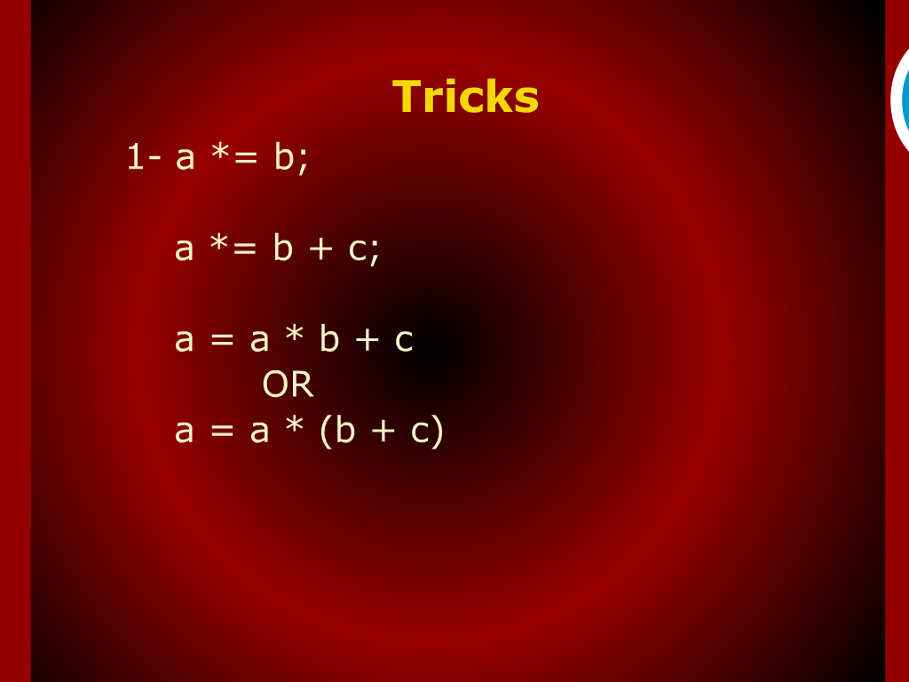
Tricks

Slide 11
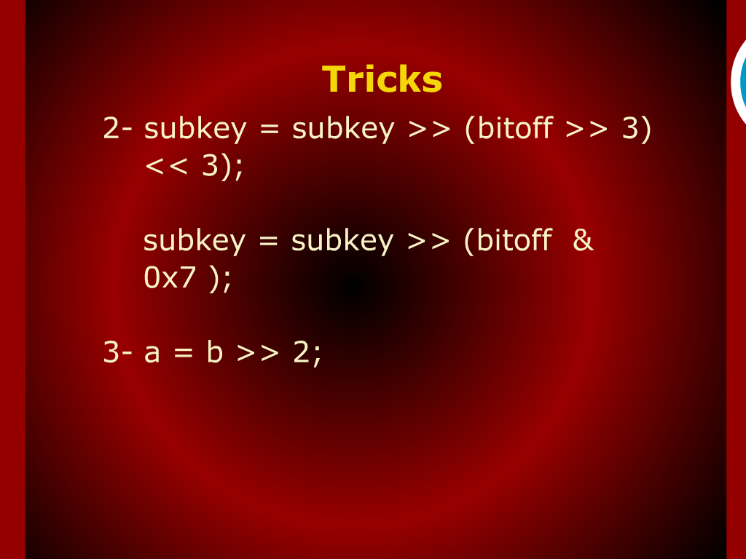
Tricks

Slide 12
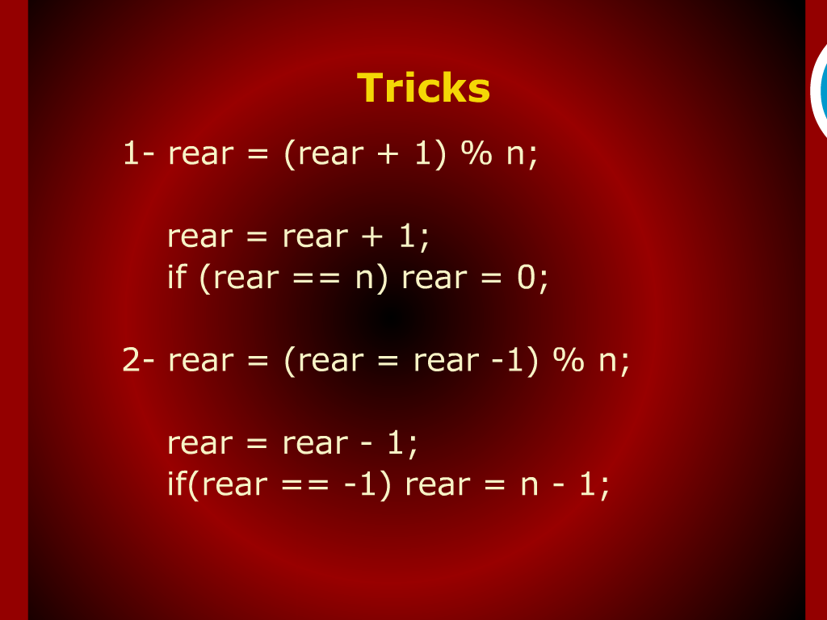
Tricks

Slide 13
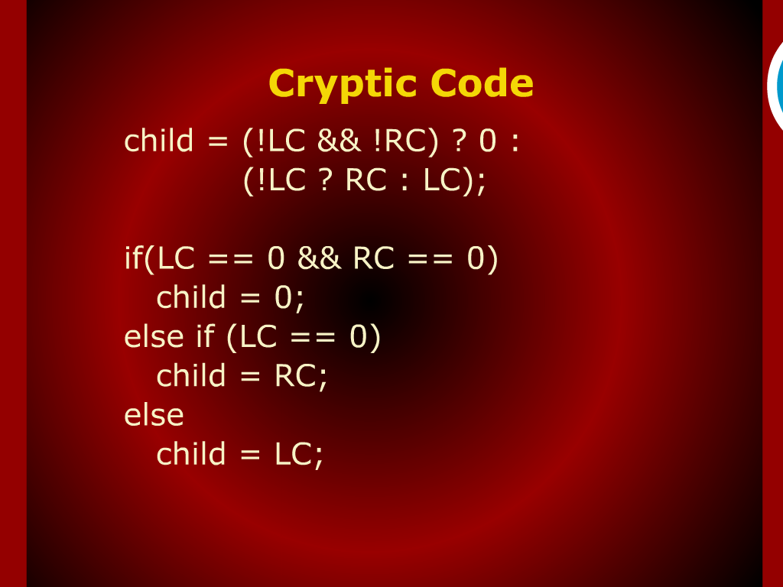
Cryptic Code

Slide 14
Complex Expression

Slide 15
Parenthesis

Slide 16
Expression and Statements

Slide 17
Summary of Today’s Lecture

Slide 18
Coding Style

